Slide 1
Waste Education Application Design Introduction
The third version

Slide 2
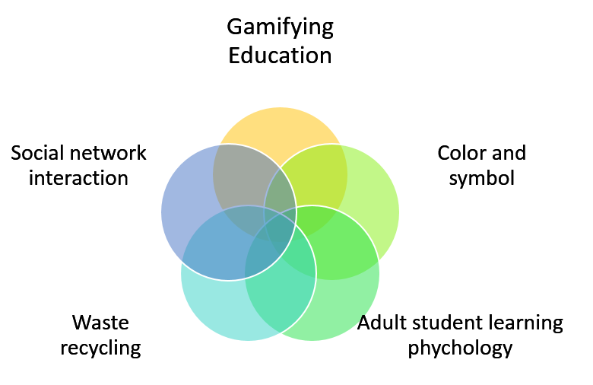
Brain Training
Gamifying Waste Education
Smart Green Mind

Slide 3



Smart

Slide 4
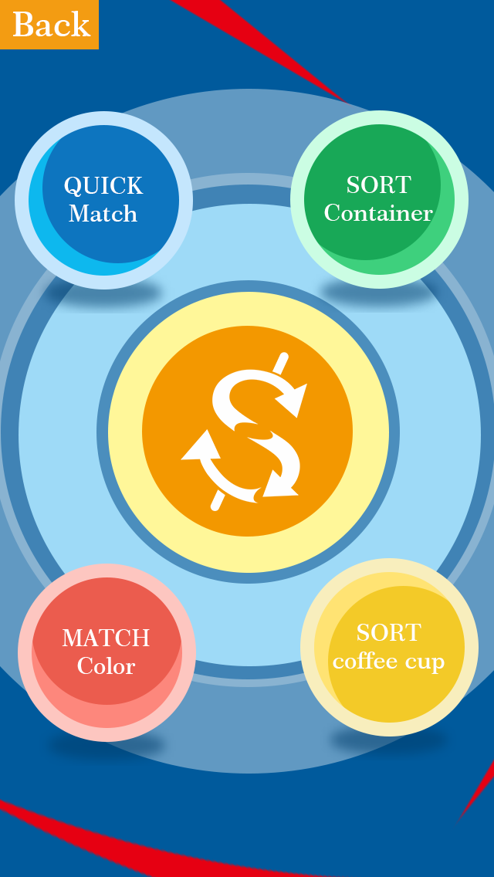
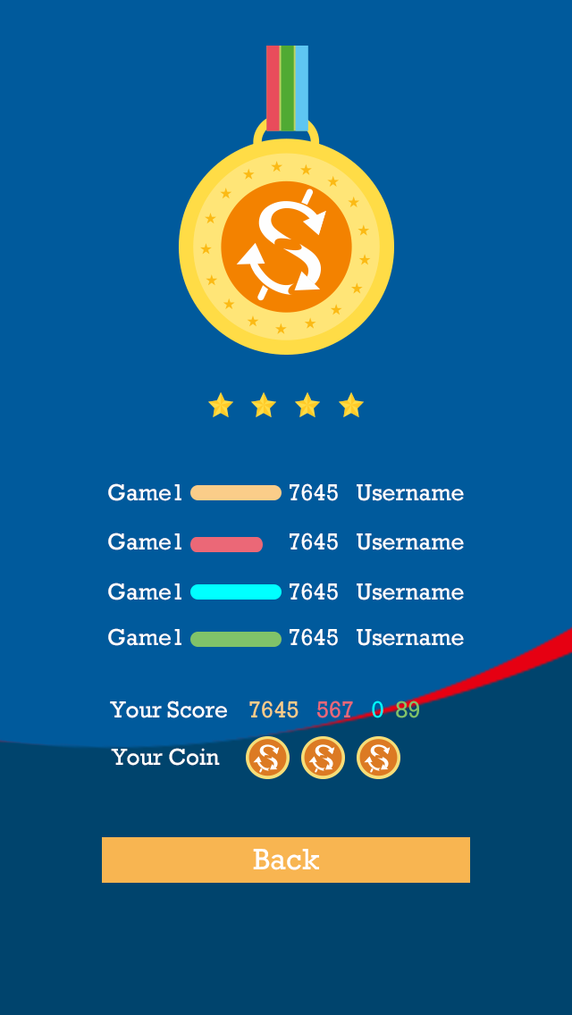
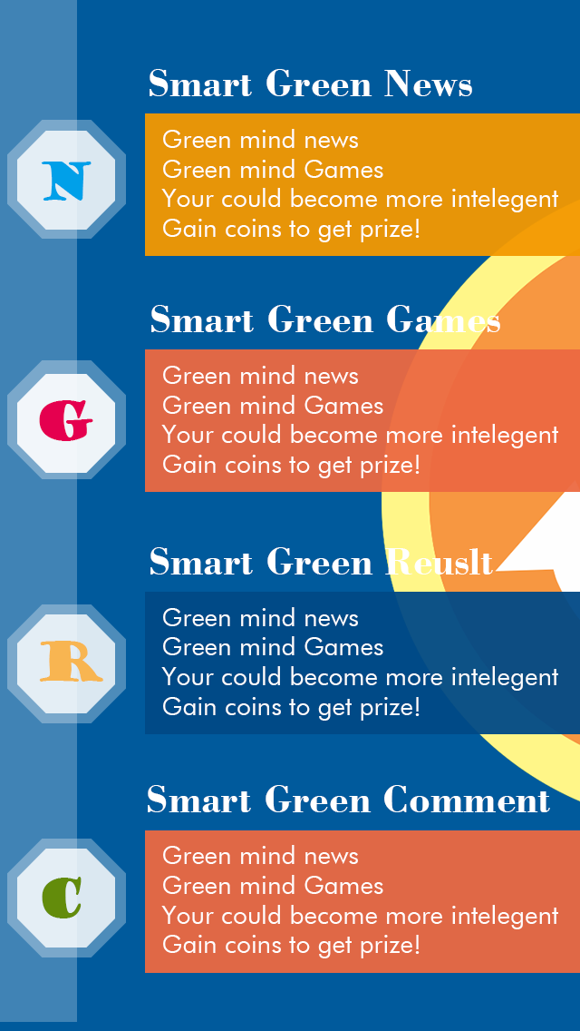
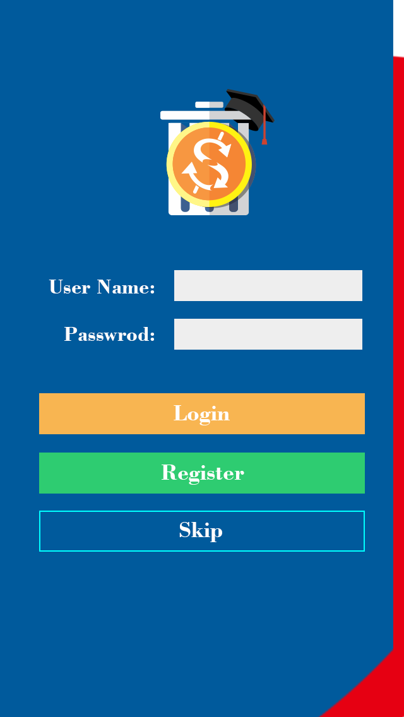

Game Menu Page
Result Page
Main Page
Login Page
Loading Page

Slide 5
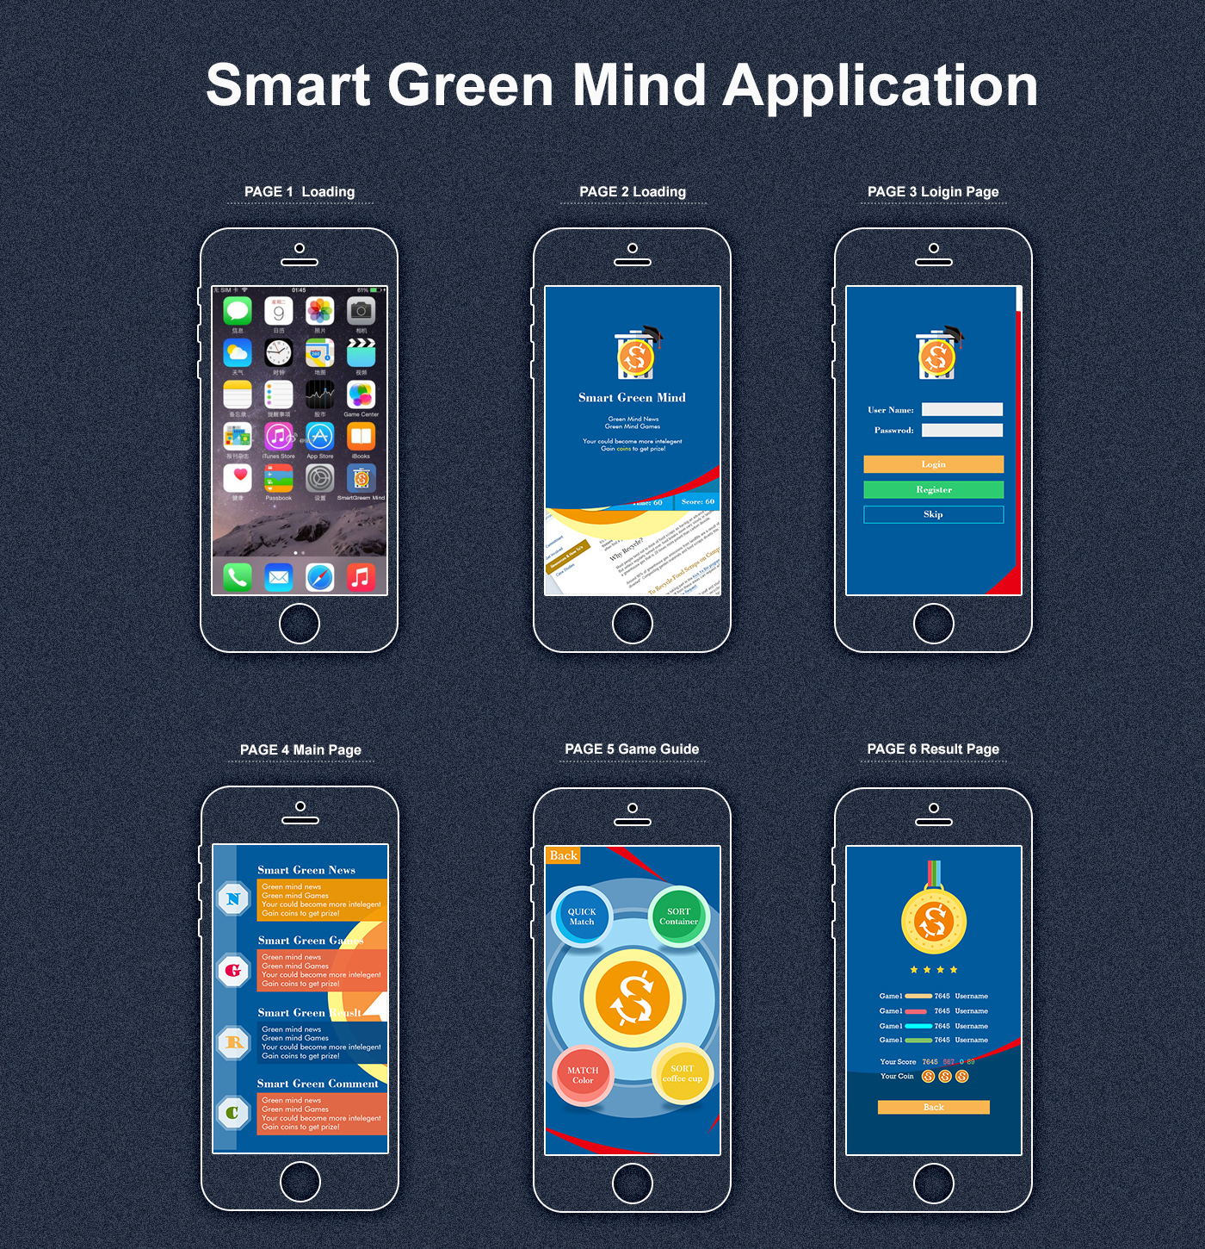
Visual Screen

Slide 6
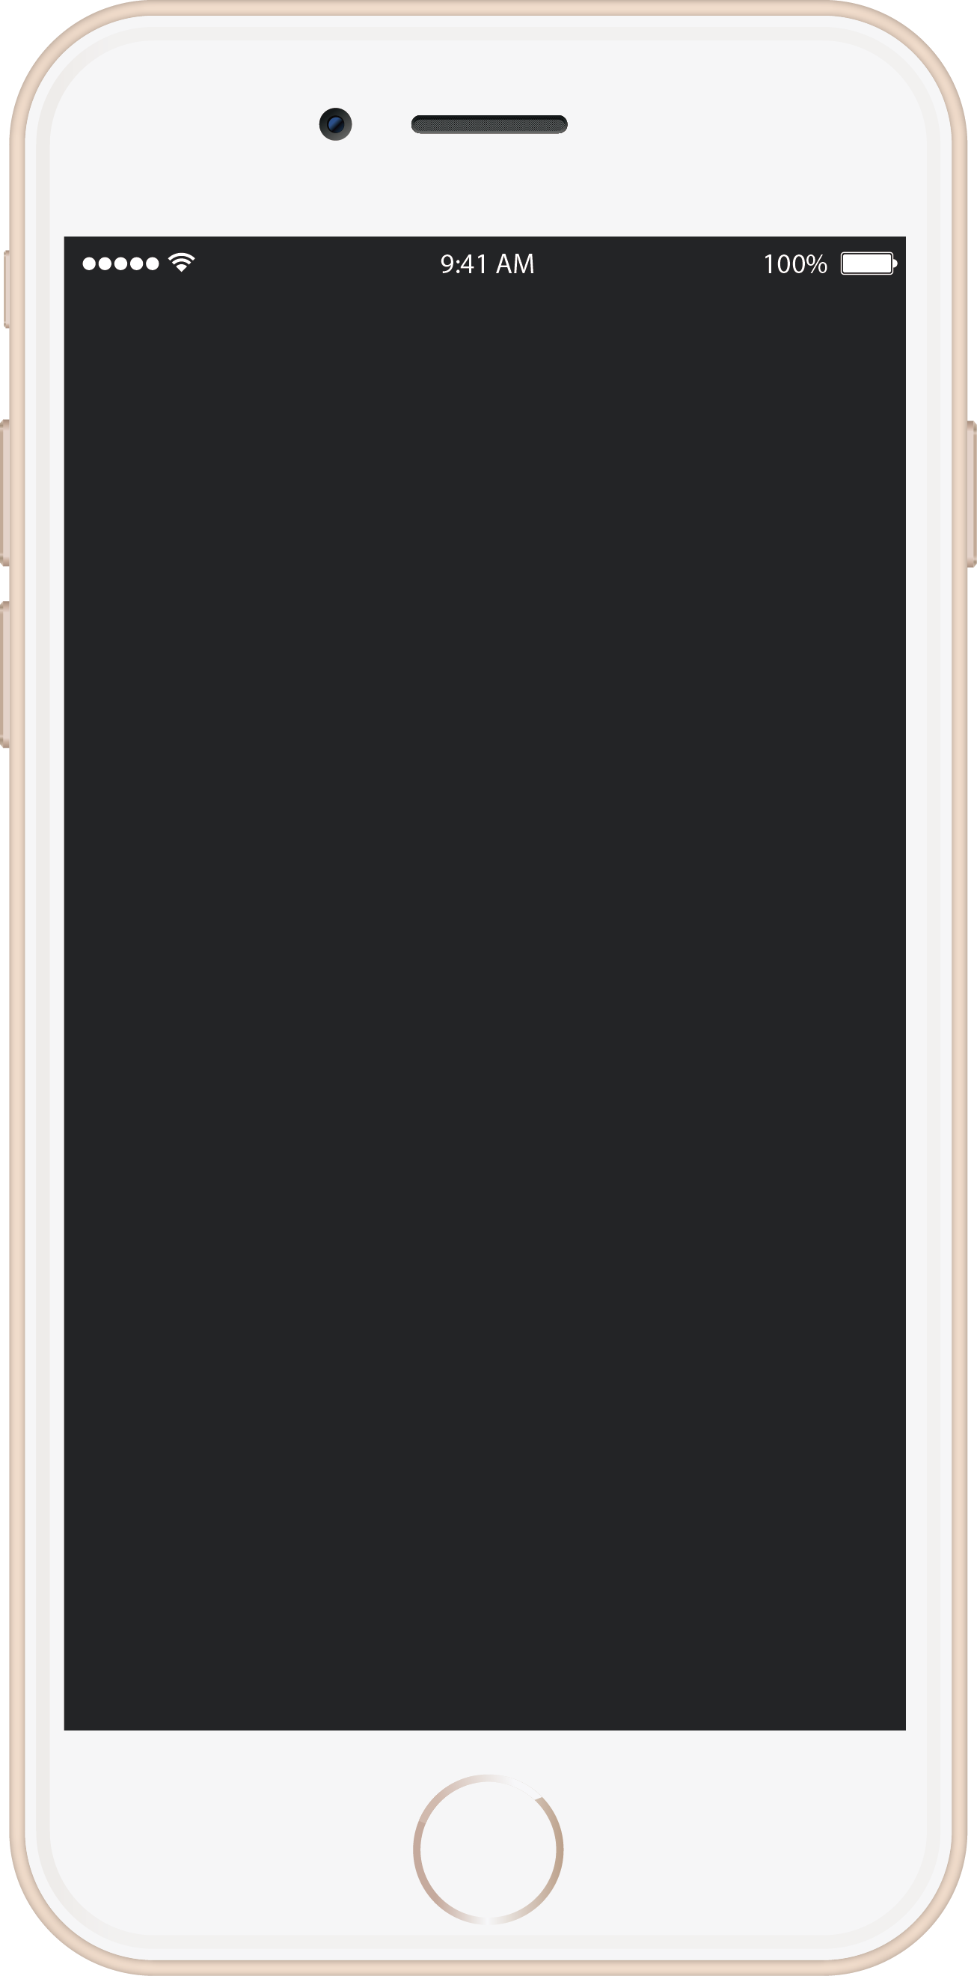
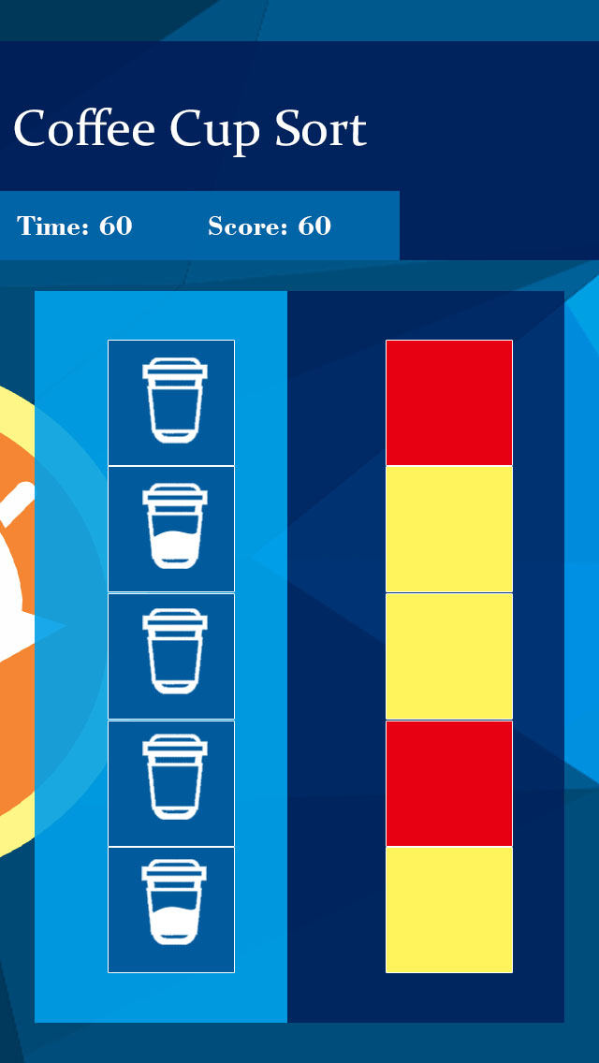
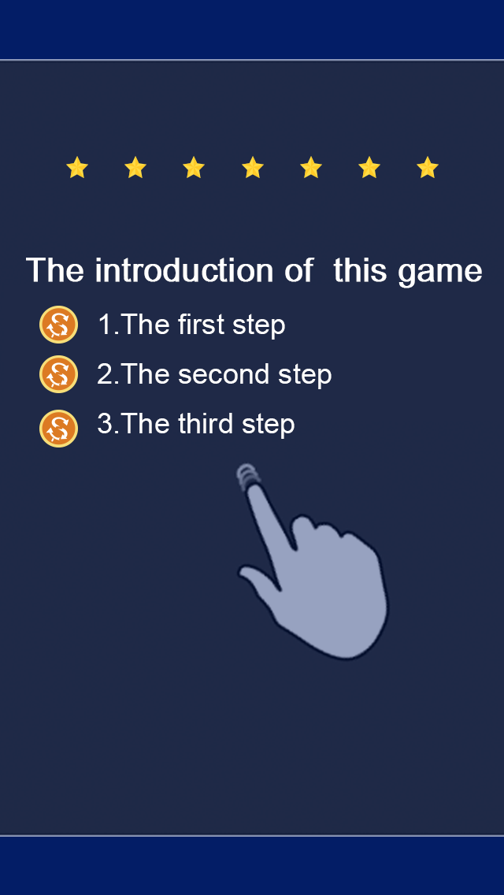
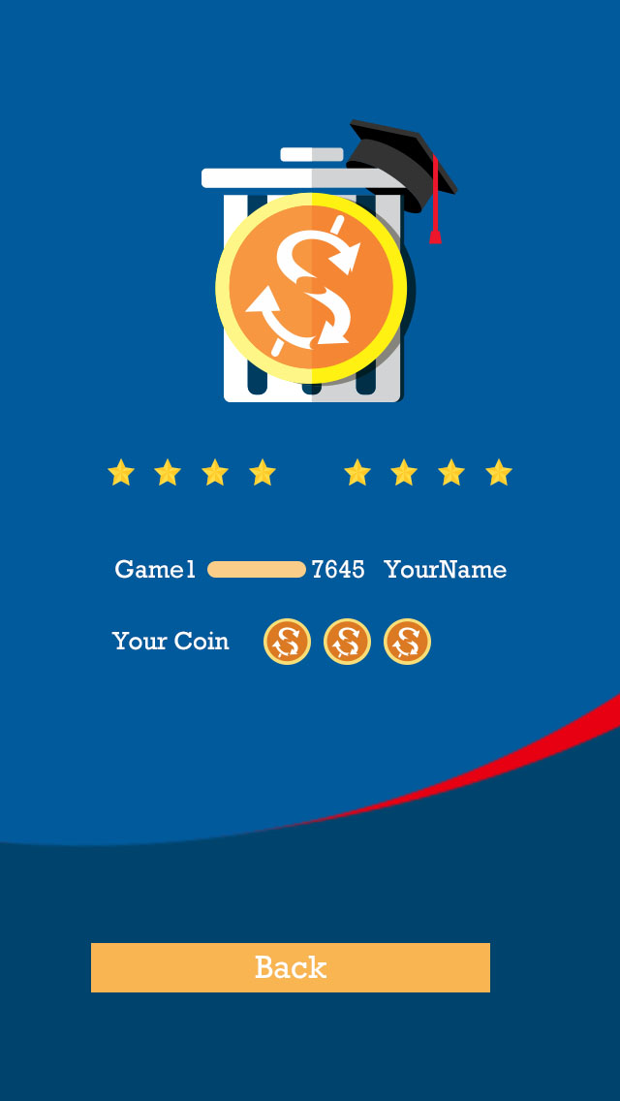
Game template
All the games star with a introduction screen.
All the games end with a result screen.
Game introduction screen
Game result screen

Slide 7


Game template
Two dynamic backgrounds
Simple blue
Deep blue
Dynamic vectors
Rolling coin

Slide 8
Game1 Sort coffee cups
Time limit is 60 seconds
Time and Score board
This game is aimed to let students to know the empty coffee cup is a very important recyclable resource.
The waste icons in this game are only empty coffee cup and coffee cup with coffee in it.
The colour block in this gare are only two. The one is yellow(Recyclable). The other is red(Land fill).
There are two sequence. The one is the sequence contains coffee cup icons. The other contains colour blocks.
The order of both coffee cup sequence and colour block sequence are random.
The number of yellow( or red) blocks equals the number of empty ( or not empty) coffee cup icons.
Random colour sequence
Random coffee cup icons sequence

Slide 9
Game1 Sort coffee cups
The initial number of sequence is 3
The total number of yellow blocks equals the total number of empty coffee cup icons
User should firstly choose a icon (or a block ), and then choose the right colour(or icon). For example, player choose a empty coffee cup icon first, and then should choose a yellow block. If this match is correct, the selected coffee cup icon and colour block will fade away. Player then get 50 marks. If match is wrong, 25 scores will be subtracted.
If all the icons and blocks are totally matched correctly, the tow sequence will be refreshed with anther random sequences of icons or blocks.
The initial number of sequence is 3, the second is 5 and then 7,9,11……
The time limit is 60 seconds.
Player need to match the icon and colour block right
If all colours match the icons correctly, new round begins.

Slide 10
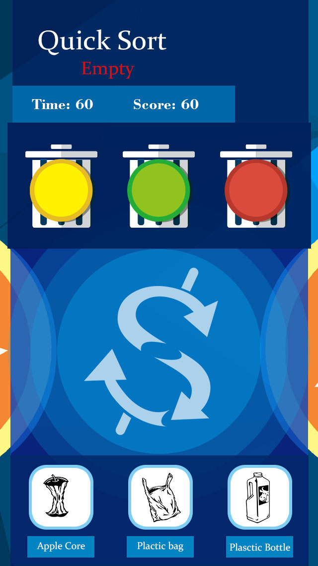
Game 2 Quick sort
Time limit is 60 seconds
Time and Score board
This game is a general waste sort education game.
The total waste icons type of this game are 21.
In the top of the game zone, there are 3 types of waste bins with corresponding colours (yellow, green and red).
In the bottom of the game zone, there are 3 random waste icons with name.
Player need to drag the waste icon into the right wast bin. If correct, a new random waste icon will take place of the original one and the player will get 50 marks, otherwise, 25 marks will be punished.
The time limit is 60 seconds.
* The position of each waste bin could shift during the game time.
Three types of waste bins. (The positon could shift during the game time )
Player need to drag the waste into correct bin
There are totally 21 different waste icons
Three random waste icons.

Slide 11
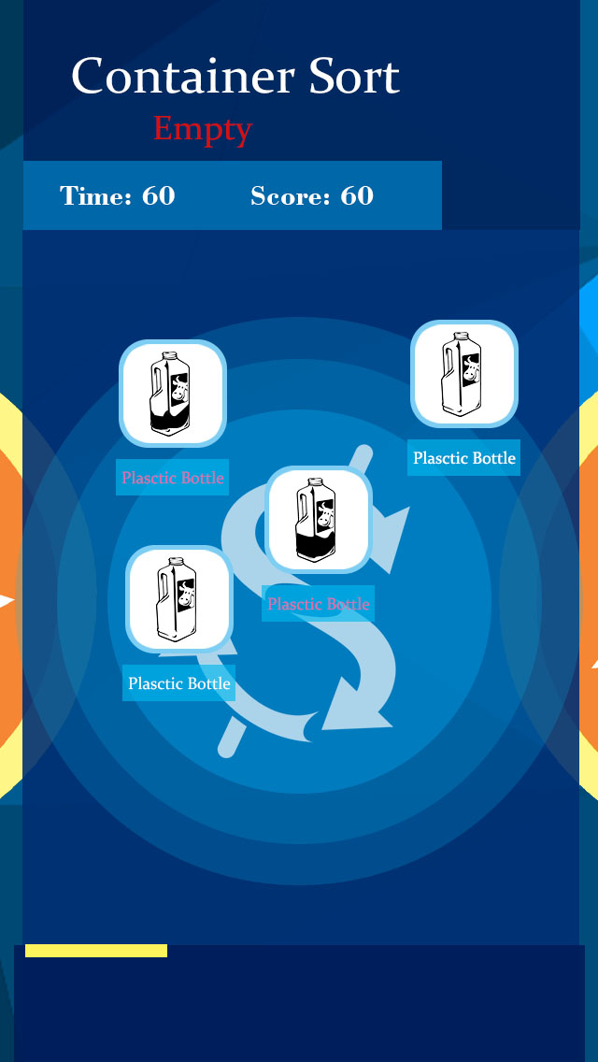
Game3 Container sort
Time limit is 60 seconds
Time and Score board
This game is aimed to educate student to distinguish the type of empty container and non-empty container carefully.
The types of container include bottle, food container etc. Each type also contains a empty icon and a non-empty icon.
The random waste icons falling down from the top of the game zone to the bottom.
Near the bottom of the game zone, there is a slider which player could drag it to move horizontally.
The colour of this slider changes between yellow and red during a random period.
Player need to drag the slider to catch the falling waste icons. If the icon type match the colour of the slider, user will be rewarded 50 marks. If wrong, 25 marks will be taken away as penalty. If a icon is falling out of the game zone, a life is lost. There are only 3 lives for player.
The speed of the falling icons will increase gradually during the game time.
The time limit of the game is 60 second.
The icons of waste are tow categories. The one is empty container. The other is container with waste in it.
Player need to drag the Slider to catch the icons.
The speed of icons falling will speed up during the game.
Slider. The color of it changes between yellow and red
If icon falling out of the game zone, player will lose a life.

Slide 12
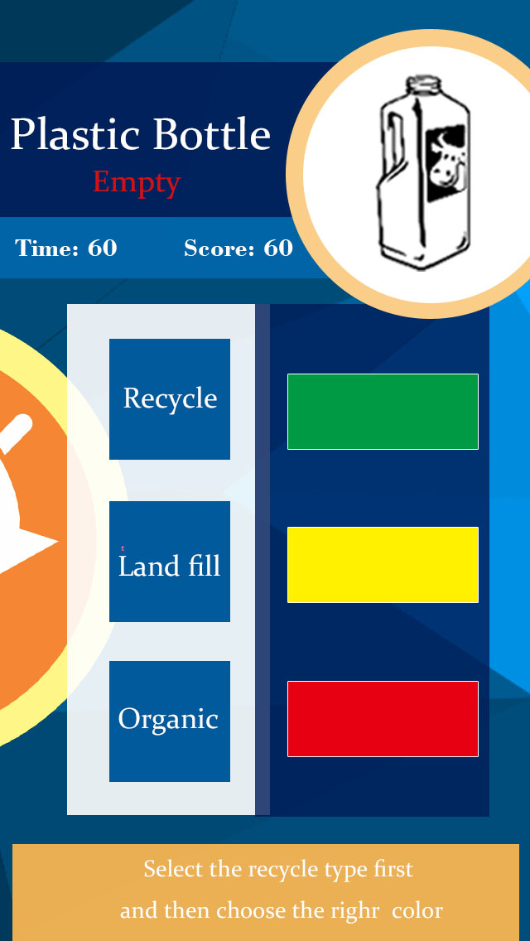
Game 4 Quick match (level 1)
Waste name board
The waste board. There totally 21 types of waste displayed randomly on the waste board.
Time limit is 60 seconds
Colour bar zone. Initially, this zone is locked. All the bars are grey. If the player choose the right waste type button, this zone will be active.
This game is a general waste sort education game.
This game could be divided into 3 levels.
The first level is quite simple. The totally 21 types of waste icons will be displayed on the waste board randomly.
According to the waste type, player should select waste button first. 3 waste types buttons will be displayed with waste type on them. If player’s selection is correct, 25 marks will be given as prize. If wrong 25 marks will be taken.
If player choose the right waste type button, the button zone will be locked, all the buttons will turn to grey with no word on them. At the same time the colour zone will be active. 3 colour bars will be shown with random colour.
The player should choose the right colour bar. If correct, 25 marks will be given. The new round begins. Otherwise, 25 marks will be taken.
The time limit is 60 second.
Button zone.3 waste type buttons displayed with random waste type on them.
If player choose correct waste type button, this zone will be locked. All the buttons will turn into grey without any word on them
Three color bars will be displayed with random color.
If icon falling out of the game zone, player will lose a life.

Slide 13
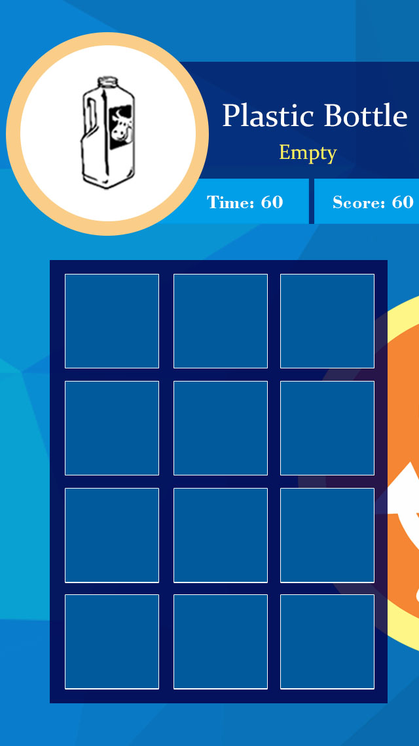
Game 4 Quick match (level 2)
The waste board. There totally 21 types of waste displayed randomly on the waste board.
Waste name board
Time limit is 60 seconds
The second level. The totally 21 types of waste icons will be displayed on the waste board randomly.
Game zone contains 3×4 color blocks with random color. All the color blocks initially are covered by the same masks
After 3 seconds, All the mask will fade away. Player need to click all the right color blocks according to the waste type. A right click will be rewarded 25 marks, otherwise the same marks will be taken. A life will also be lost.Player only has 2 lives in each round.
If all the right colour blocks are clicked, new round begins.
The time limit is 60 second.
Game zone contains 3×4 random color blocks.
A right click will be rewarded 25 marks.
All the color blocks initially are covered by the same masks
After 3 seconds, All the mask will fade away. Player need to click all the right color blocks according to the waste type
If all the right colour blocks are clicked, new round begins.

Slide 14
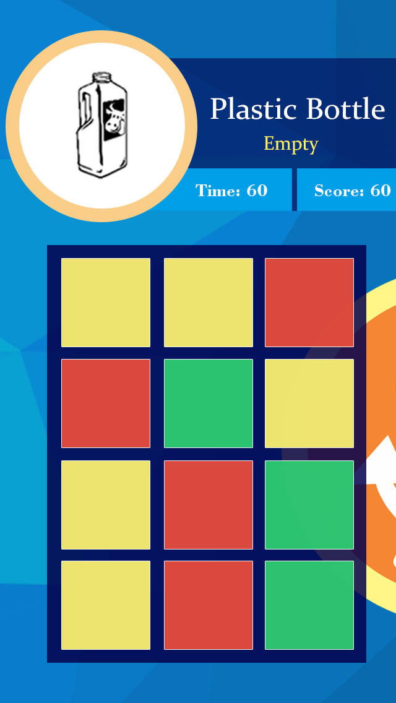
Game 4 Quick match (level 2)
The waste board. There totally 21 types of waste displayed randomly on the waste board.
Waste name board
Time limit is 60 seconds
The second level. The totally 21 types of waste icons will be displayed on the waste board randomly.
Game zone contains 3×4 color blocks with random color. All the color blocks initially are covered by the same masks
After 3 seconds, All the mask will fade away. Player need to click all the right color blocks according to the waste type. A right click will be rewarded 25 marks, otherwise the same marks will be taken. A life will also be lost.Player only has 2 lives in each round.
If all the right colour blocks are clicked, new round begins.
The time limit is 60 second.
Game zone contains 3×4 random color blocks.
A right click will be rewarded 25 marks.
All the color blocks initially are covered by the same masks
After 3 seconds, All the mask will fade away. Player need to click all the right color blocks according to the waste type
If all the right colour blocks are clicked, new round begins.

Slide 15
Game 4 Quick match (level 3)
The waste board. There totally 21 types of waste displayed randomly on the waste board.
Waste name board
Time limit is 60 seconds
The third level. The totally 21 types of waste icons will be displayed on the waste board randomly.
Game zone contains 3×4 color blocks with random color. All the color blocks will be only displayed in 5 seconds.
After 5 seconds, All the color blocks will be covered by same masks. Player need to click all the right color blocks according to the waste type by memory. A right click will be rewarded 50 marks, otherwise the same marks will be taken. A life will also be lost.Player only has 2 lives in each round.
If all the right colour blocks are clicked, new round begins.
The time limit is 60 second.
Game zone contains 3×4 random color blocks.
All the color blocks will be only displayed in 5 seconds.

Slide 16
Game 4 Quick match (level 3)
The third level. The totally 21 types of waste icons will be displayed on the waste board randomly.
Game zone contains 3×4 color blocks with random color. All the color blocks will be only displayed in 5 seconds.
After 5 seconds, All the color blocks will be covered by same masks. Player need to click all the right color blocks according to the waste type by memory. A right click will be rewarded 50 marks, otherwise the same marks will be taken. A life will also be lost.Player only has 2 lives in each round.
If all the right colour blocks are clicked, new round begins.
The time limit is 60 second.
A right click will be rewarded 50 marks.
All the color blocks will be only displayed in 5 seconds.
After 5 seconds, All the color blocks will be covered by same masks. Player need to click all the right color blocks according to the waste type by memory.
If all the right colour blocks are clicked, new round begins.

Slide 17
Future Plan
1st
Icon design
Micro animation
2ed
User trace analysis
3rd
Energy coin
Map navigation
Result reward
System optimization
Multi level
Smart campus

